Slide 1
Making things move
Time and Space

Slide 2
Animation
Persistence of Vision/ Illusion of Motion
showing a human a sequence of still images in rapid succession is perceived as motion.
screen refresh rate: how often the screen contents are updated (from frame buffer memory)
NTSC (TV) video is 30 frames per second (29.97), film: 24fps
more is better.
fusion frequency = ~20Hz

Slide 3
Time-based motion
on different machines of differing capabilities, the time it takes to render a frame can differ
want motion to be a function of time not frame rate
use dt parameter to love.update(dt)

Slide 4
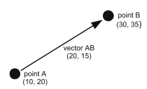
Vectors
Point = x and y coords of a point
Vector = x and y coords of a change in position
has a direction and a magnitude (length)

Slide 5
kinematic time-based motion using hump vector
vector=require('vector')
player=display.newRect(320,240, 20,20 )
player.velocity = vector(10,-30)
player.position = vector(320,240)
player.x = player.position.x
player.y = player.position.y
function update (object)
local now = system.getTimer()
local dt = (now - lastFrame) / 1000
object.position = object.position + object.velocity * dt
object.x = object.position.x
object.y = object.position.y
lastFrame = now
end
function enterFrame ( event )
update(player)
end
lastFrame = system.getTimer()
Runtime:addEventListener ('enterFrame', enterFrame)
http://vrld.github.com/hump/#vector

Slide 6
Unit Vectors
directions are usually described with vectors of magnitude of 1.0
normalize a vector == keep its direction the same, but change its length to 1.0
divide x and y components by the magnitude
vector:normalized()
vector:normalize_inplace()

Slide 7
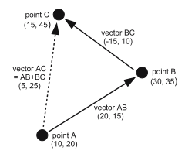
Vector Addition
add components separately
same effect as the two vectors in sequence: head-to-tail
A = vector(10,20)
B = vector(30,35)
C = vector(15,45)
BC = C - B
AB = B - A
AC = AB + BC

Slide 8

Vector Subtraction
A
result vector for A - B :
head at A
tail at B
component-wise subtraction
B

Slide 9
Vector Negation
flips direction
magnitude the same
negA = -A

Slide 10
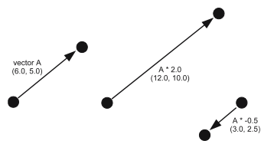
Scalar Multiplication and Division
multiply (divide) each component by the scalar
A = A * 2.0
or
A = 2 * A
keeps direction, changes magnitude
multiply (divide) by 1.0 == no change
multiply (divide) by -1.0 == negate
multiply by value > 1.0 == increase magnitude
mulitply by value < 1.0 == decrease magnitude

Slide 11
Using Vectors for Motion
keep position and velocity for each moving object
in enterFrame handler:
position = position + velocity * dt

